Slide 1
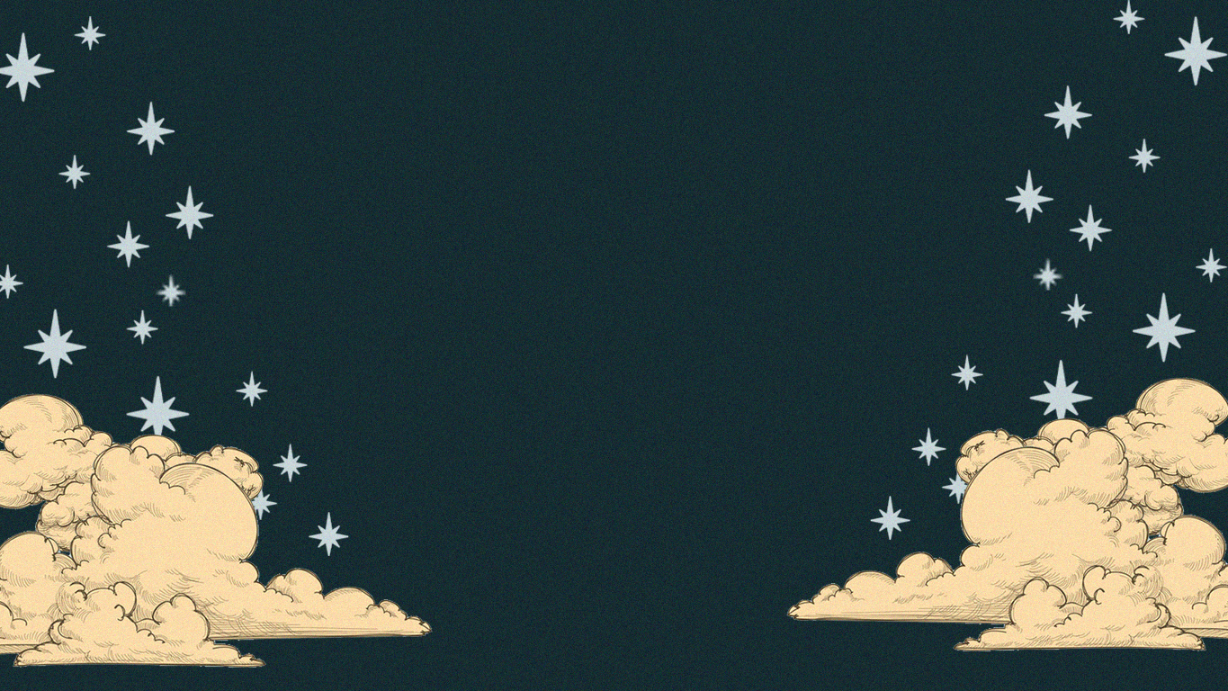
Welcome To
Musico
Zyrus Soriano’s
The Mythical World of Music

Slide 2
Musico
Musico is a mythical world of music where each music genre has their own Gods and Goddesses.
The world of Musico was once lived in unity and harmony but it was devided when different other music genres came out. People have different taste and vibes when it comes to music hence the world of Musico will never die although it will never be the same.

Slide 3
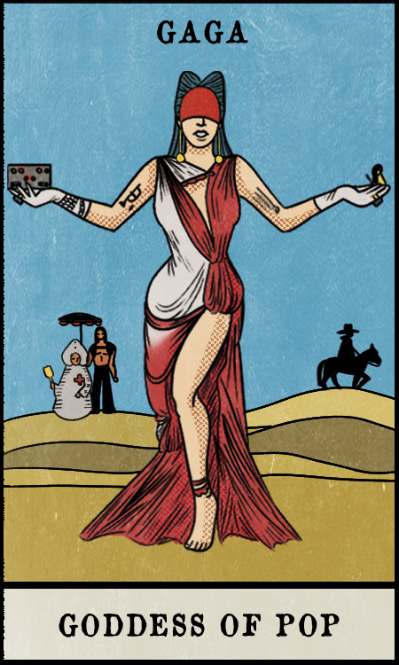
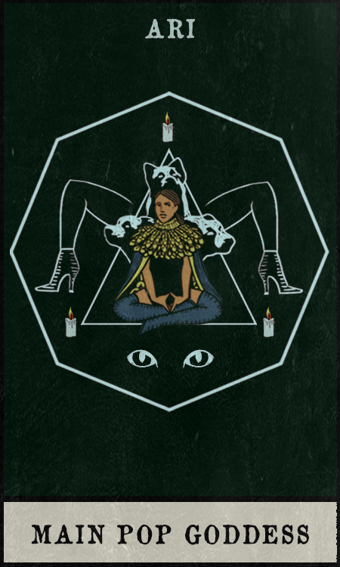
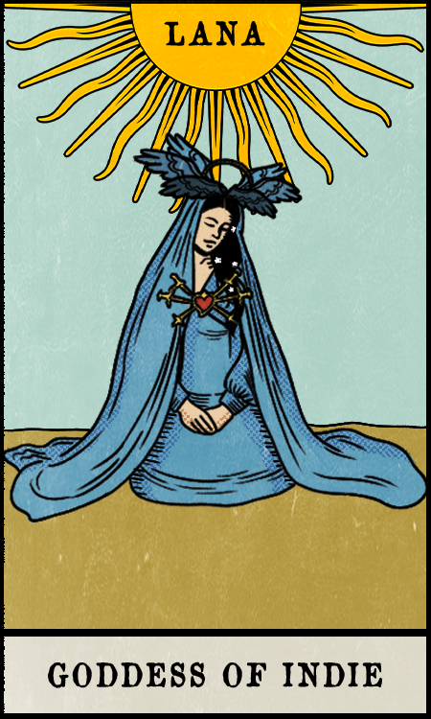
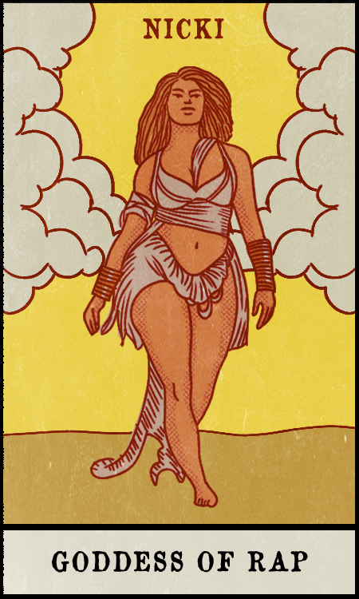
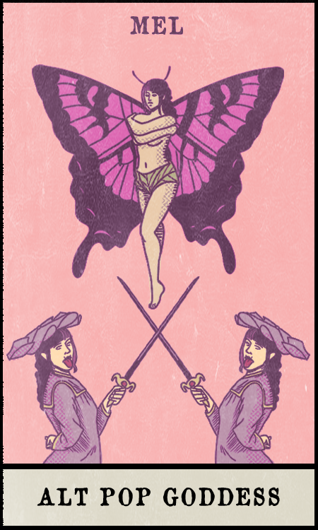
Pick a Card, Iho’t Iha

Slide 4
Gaga, the Mother Monster
Goddess of Pop
Background: After defeating the former Goddess of Pop, Madonna in a singing battle war, she became the new generation’s Goddess of Pop.
Power: She’s the only one who can transform into any genres, gave birth into a new genre and the one that can end a particular genre. She’s unbeatable.
She’s a Goddess and a Monster.
Pick Here

Slide 5
Ariana, The Vocal Monster
One of the Main Pop Goddess
Background: Ariana is Mariah Carey’s most beloved student but after the mysterious disappearance of the Goddess Mariah Carey, Ariana replaced Mariah and continue her legacy.
Power: She can make other Gods and Goddesses disappear with her bird-like whistle tone and she can put a particular genre at risk and make it flop or come near to its extinction.
Pick Here

Slide 6
Lana, The Mistress of Misery
The Goddess of Indie
Background: After Marrying the Rock God Elvis, Lana killed him and became a Goddess. Making Rock & Roll fade into the scene, so she can make Indie more powerful.
Power: As the Goddess Witch and a Cult Leader, she can cast a spell to any Gods and Goddesses, make them weak and steal their soul. Can also make a genre powerful.
Pick Here

Slide 7
Nicki, The Diss Monster
The Goddess Of Rap
Background: Before becoming the Goddess of Rap, she was part of the underground music group ‘Wrath Rippers” that is against the Gods & Goddesses of Musico. She was offered to be the Goddess of the new genre created by Gaga, The Rap of Musico but in exchange for that, Nicki needs to betray the Wrath Rippers.
Power: Can diss any Gods and Goddesses to filth until its reputation is ruined.
Pick Here

Slide 8
Melanie, The Dark Fairy
The Alternative Pop Goddess
Background: Living in an alter world of Musico, Melanie is the undiscovered child of Musico until one day, Gaga and Lana join their forces on summoning the last child of Musico.
Power: She can manipulate the memories of anyone, she can merge genres and is equivalent with the Goddess of Pop.
Pick Here

Slide 9
See you soon at
Musico

